Slide 1
ARKBot assembly

Slide 2
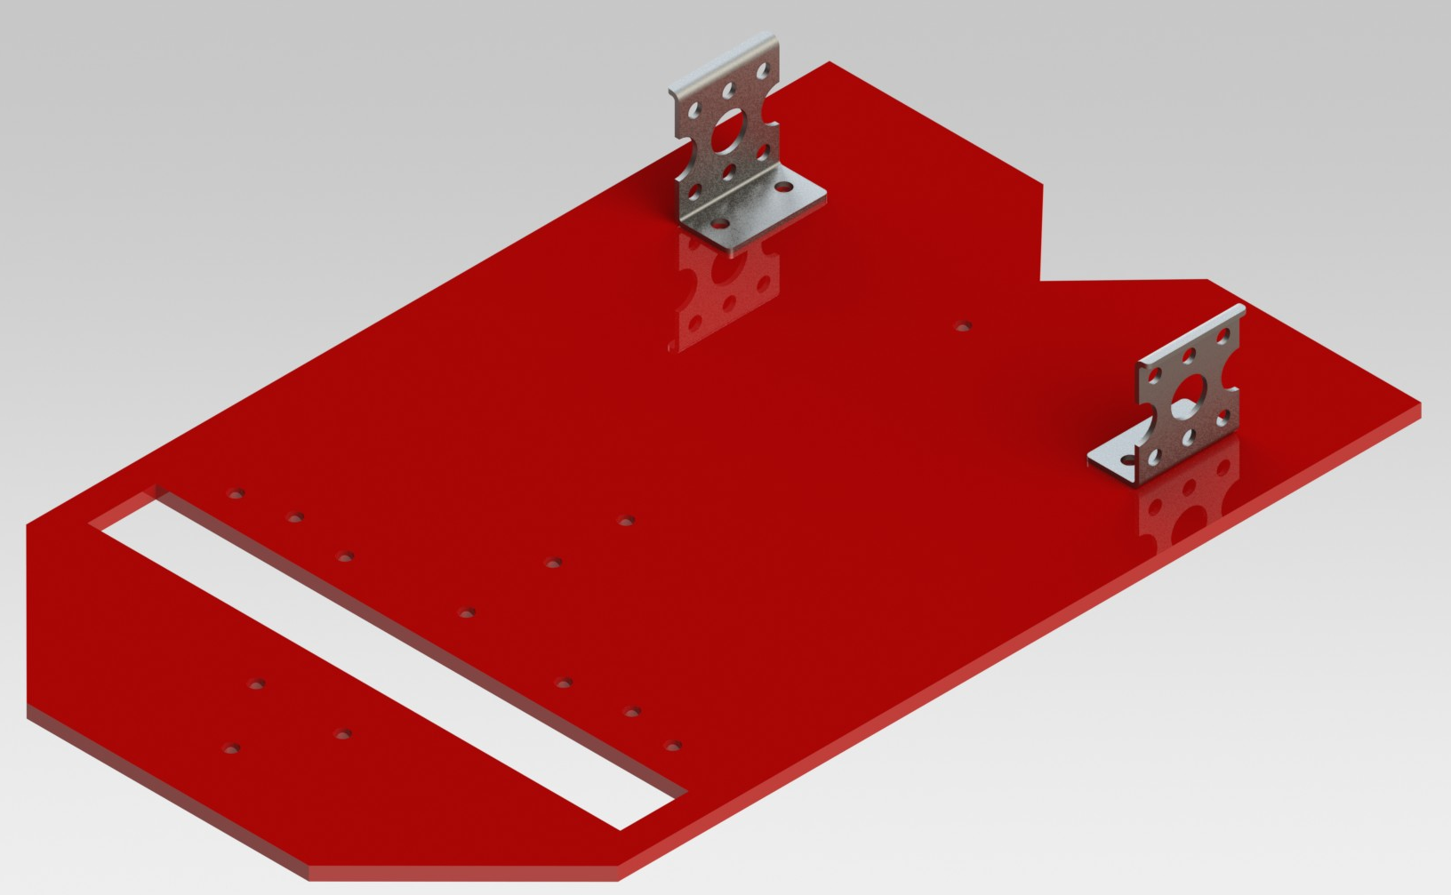
Placing the L-Clamps

Slide 3
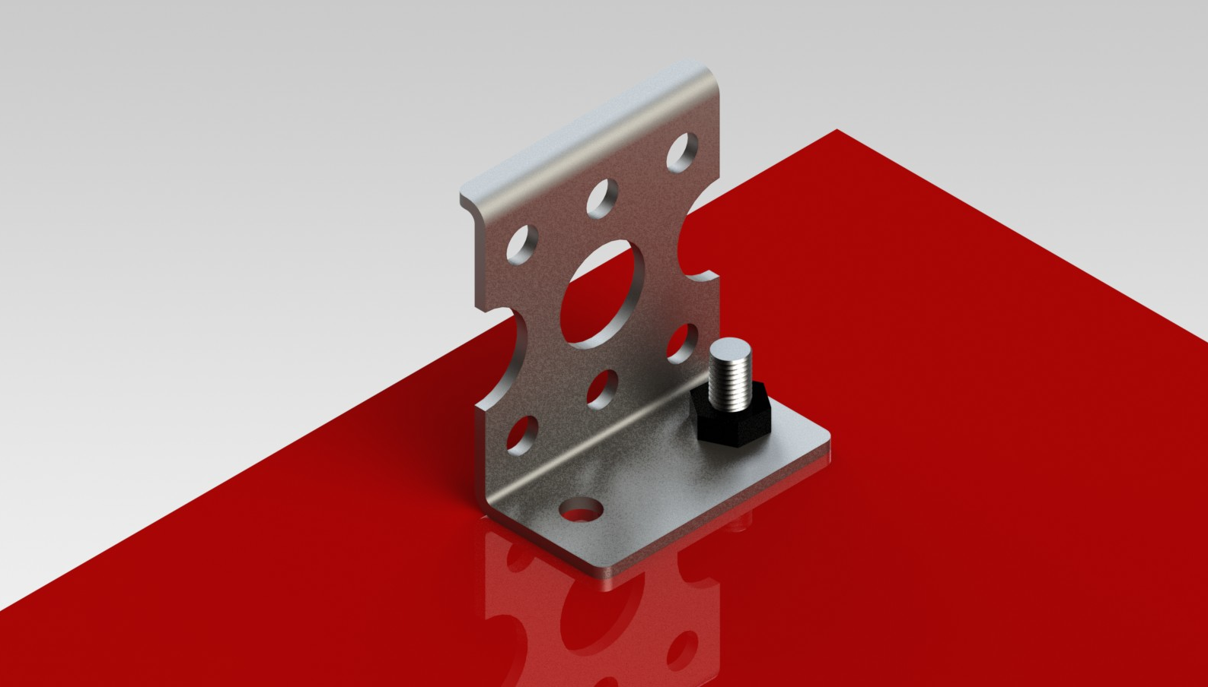
Placing the L-Clamps

Slide 4
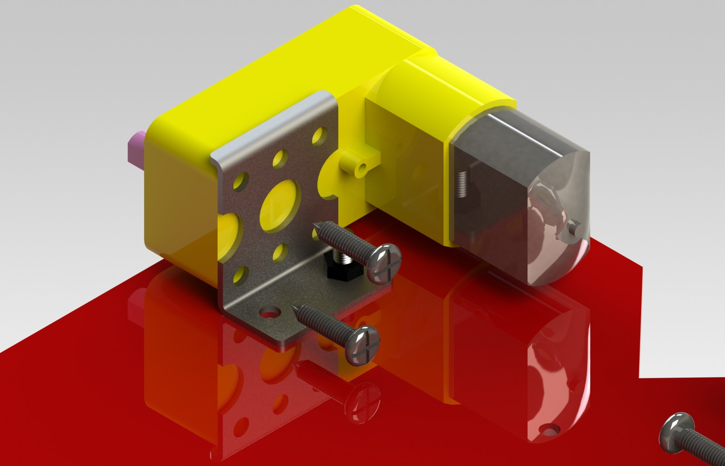
Placing the Motors

Slide 5
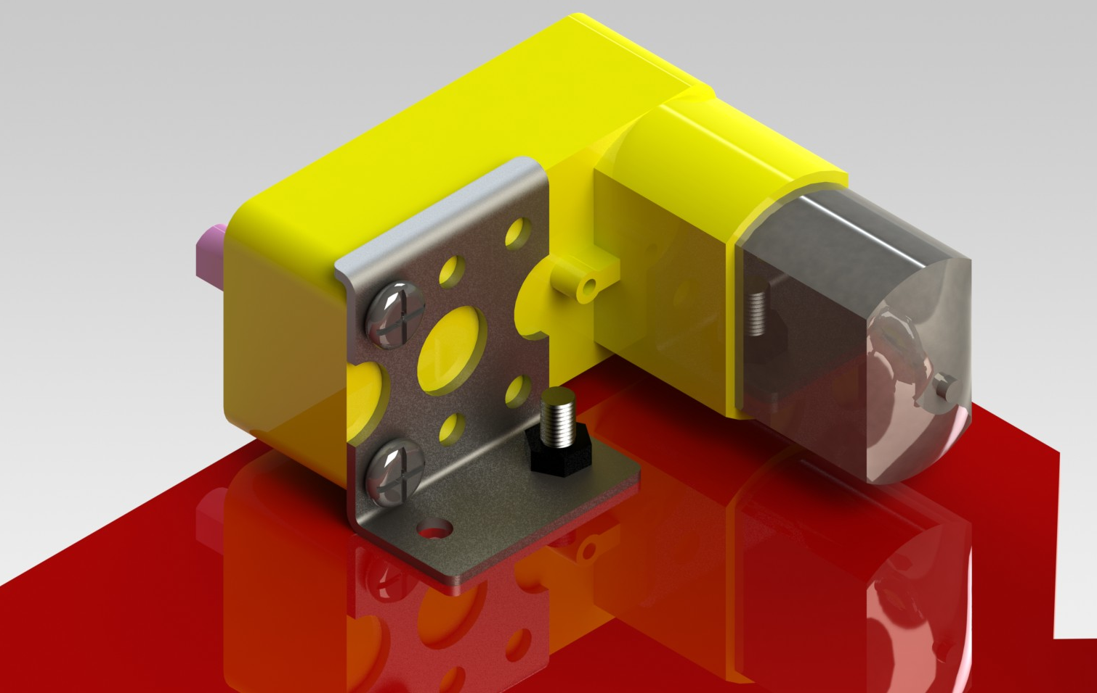
Placing the Motors

Slide 6
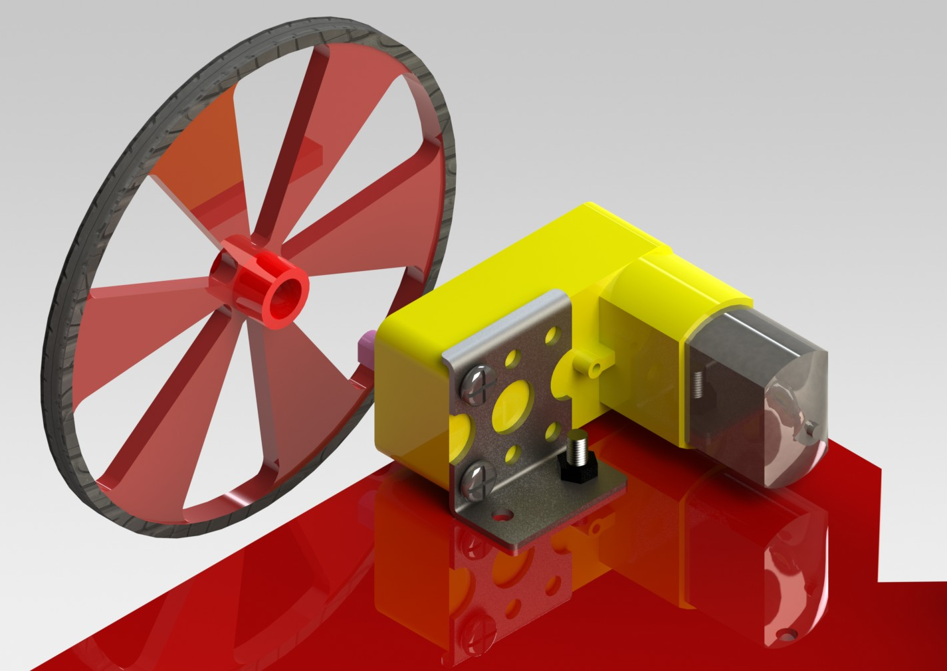
Placing the Wheels

Slide 7
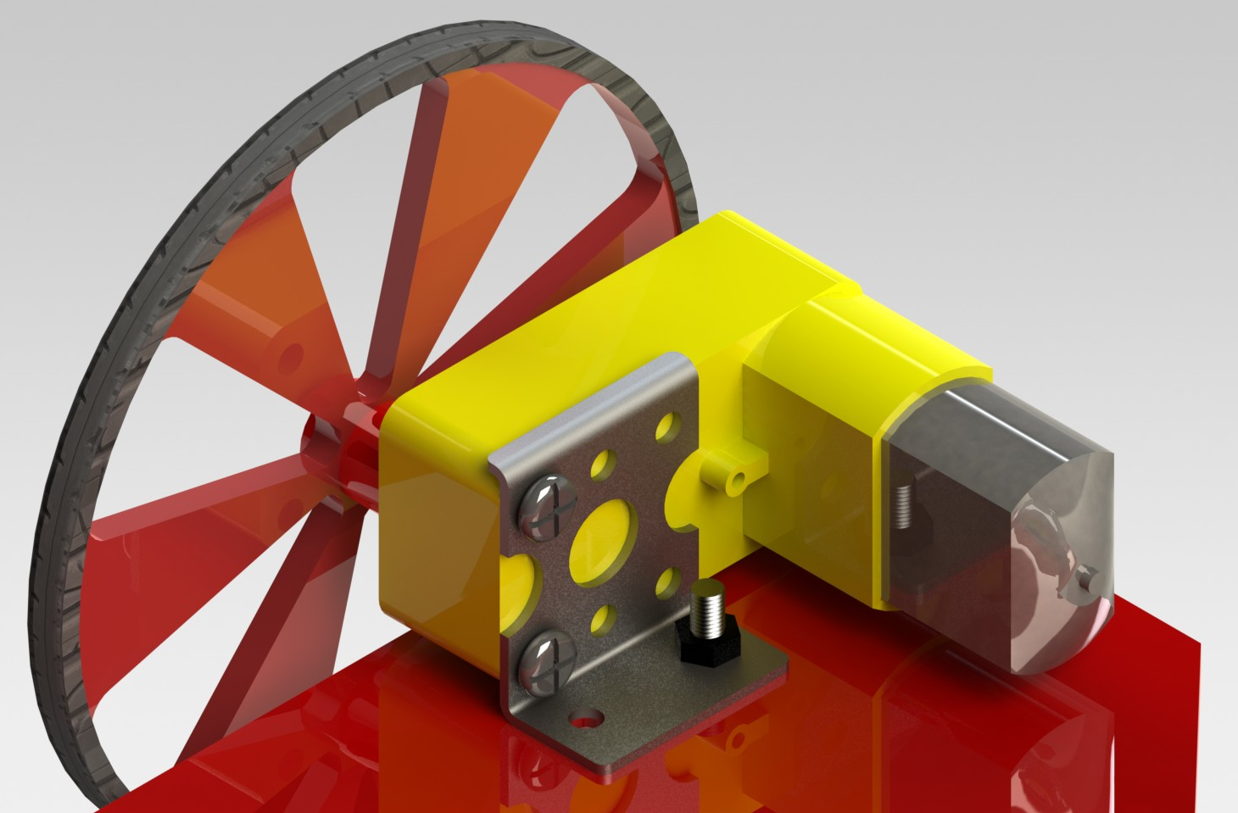
Placing the Wheels

Slide 8
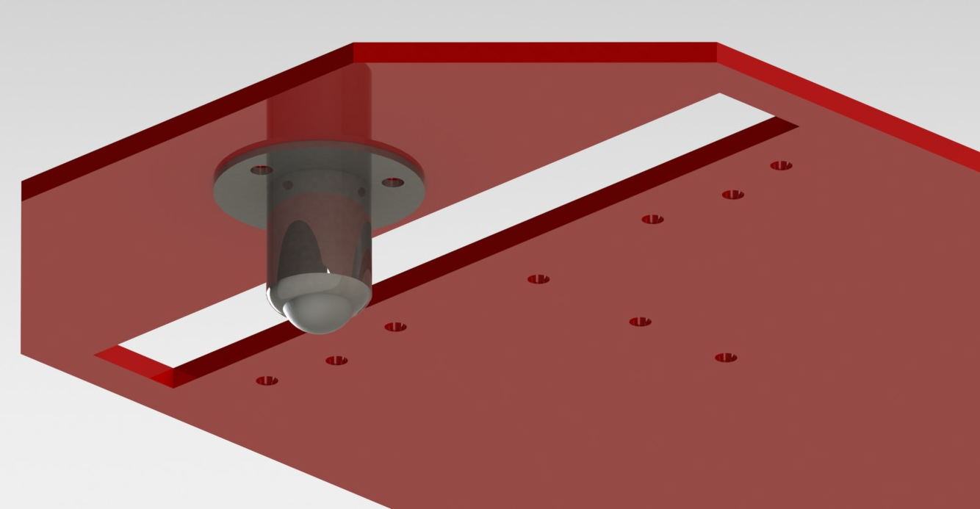
Placing the Castor Wheels

Slide 9
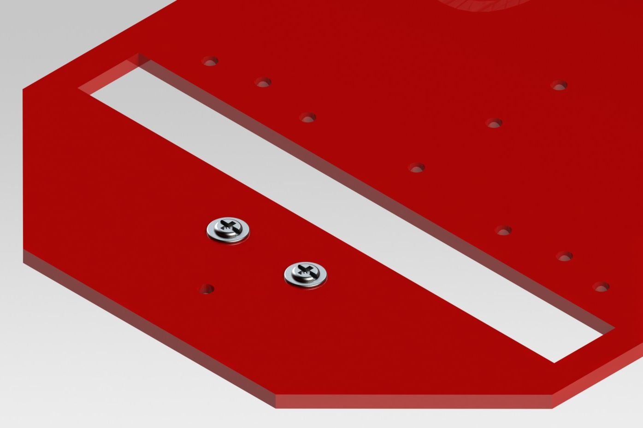
Placing the Castor Wheels

Slide 10
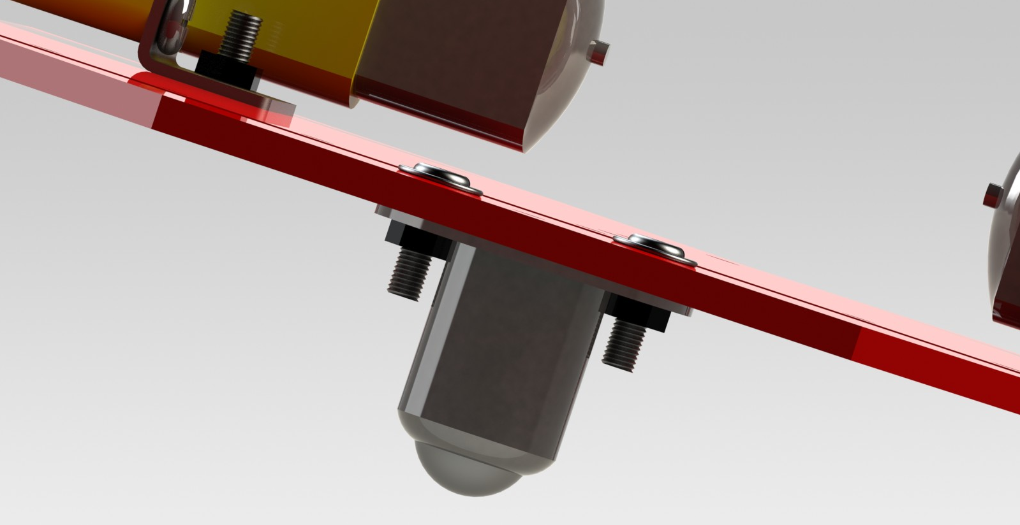
Placing the Castor Wheels

Slide 11
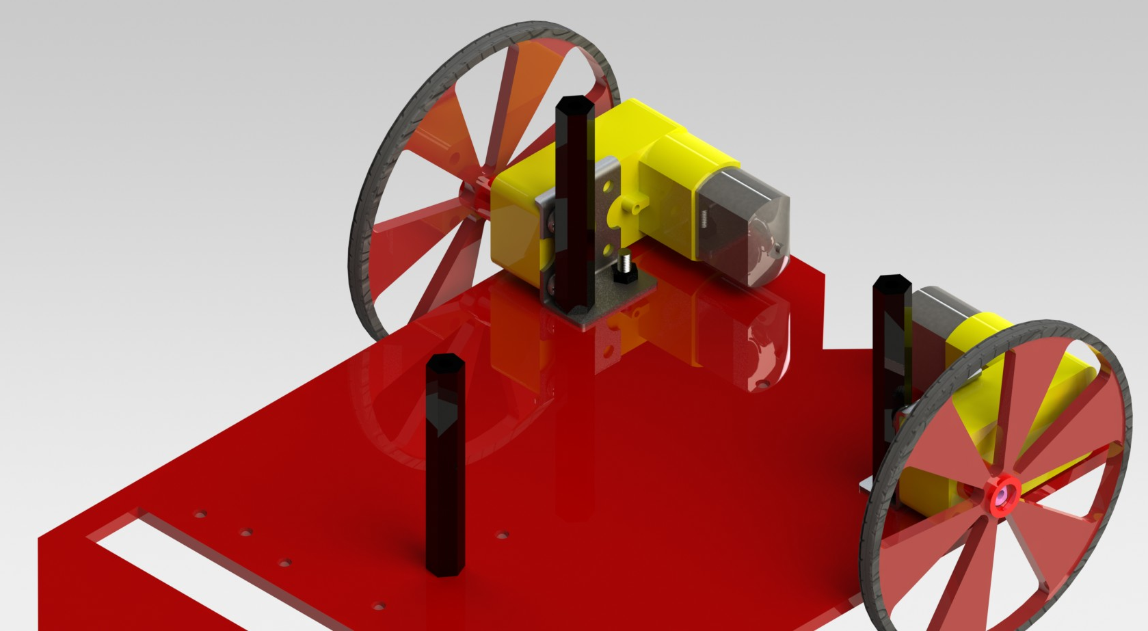
Placing the Spacers

Slide 12
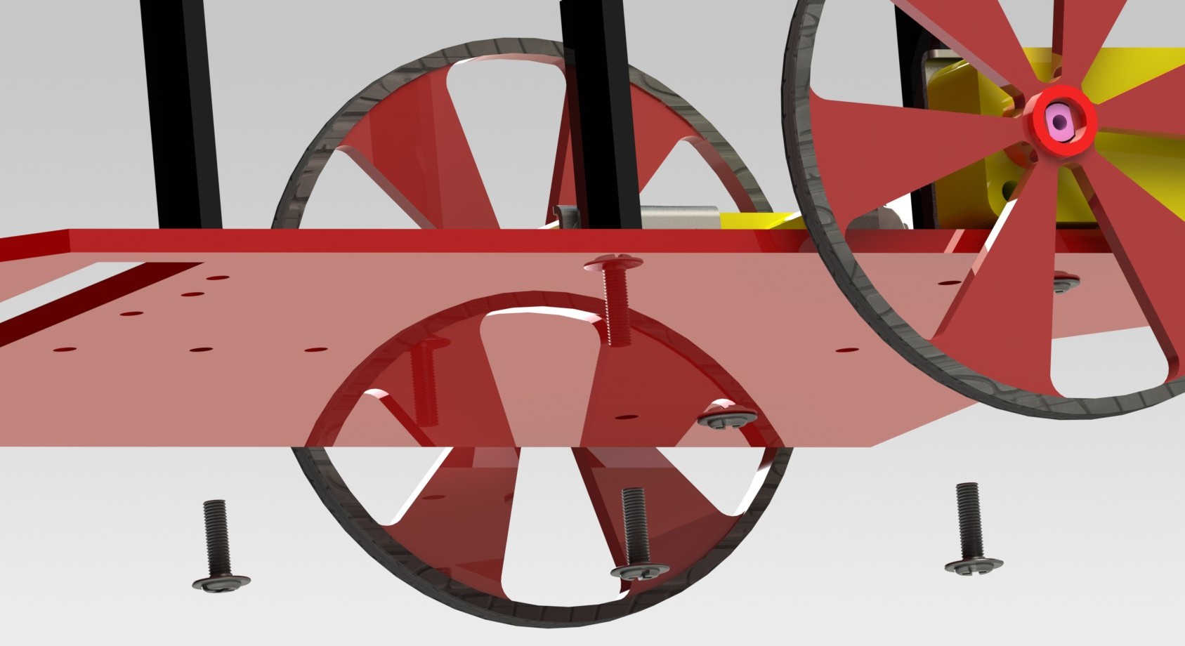
Placing the Spacers

Slide 13
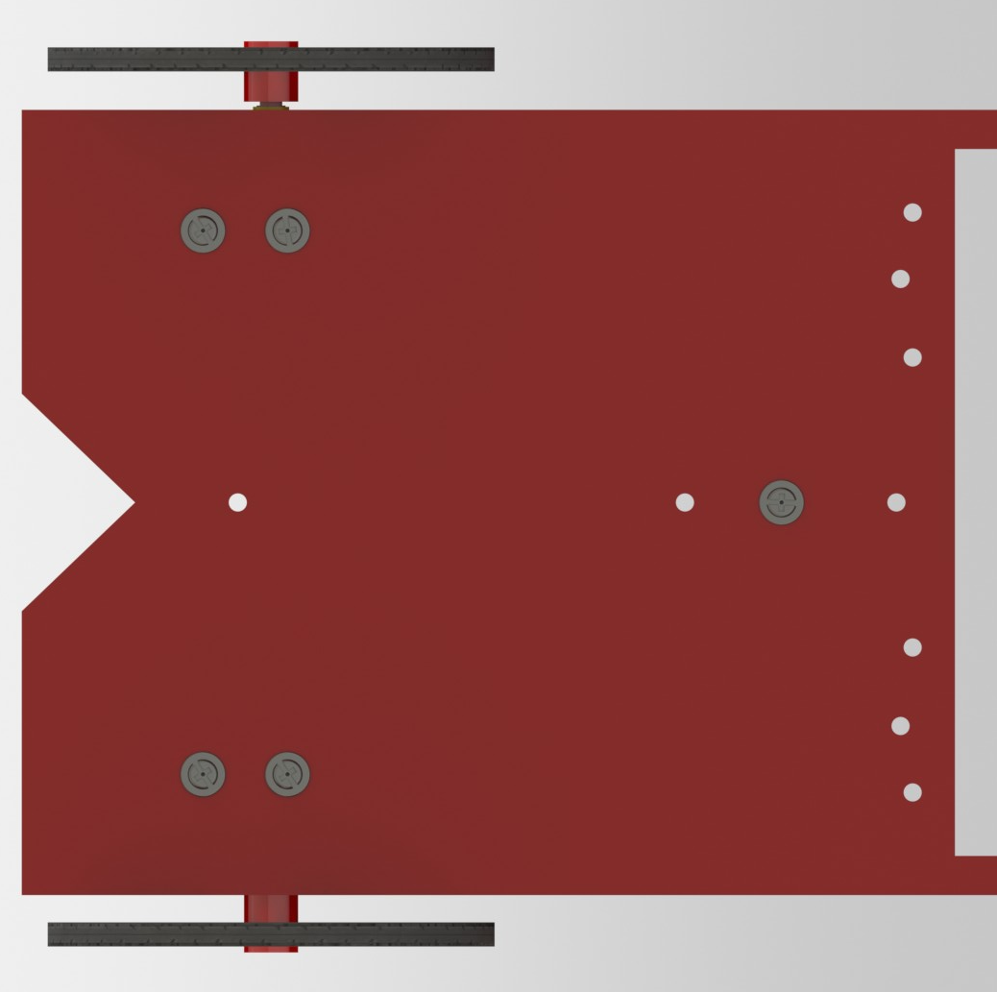
Screws Placement

Slide 14
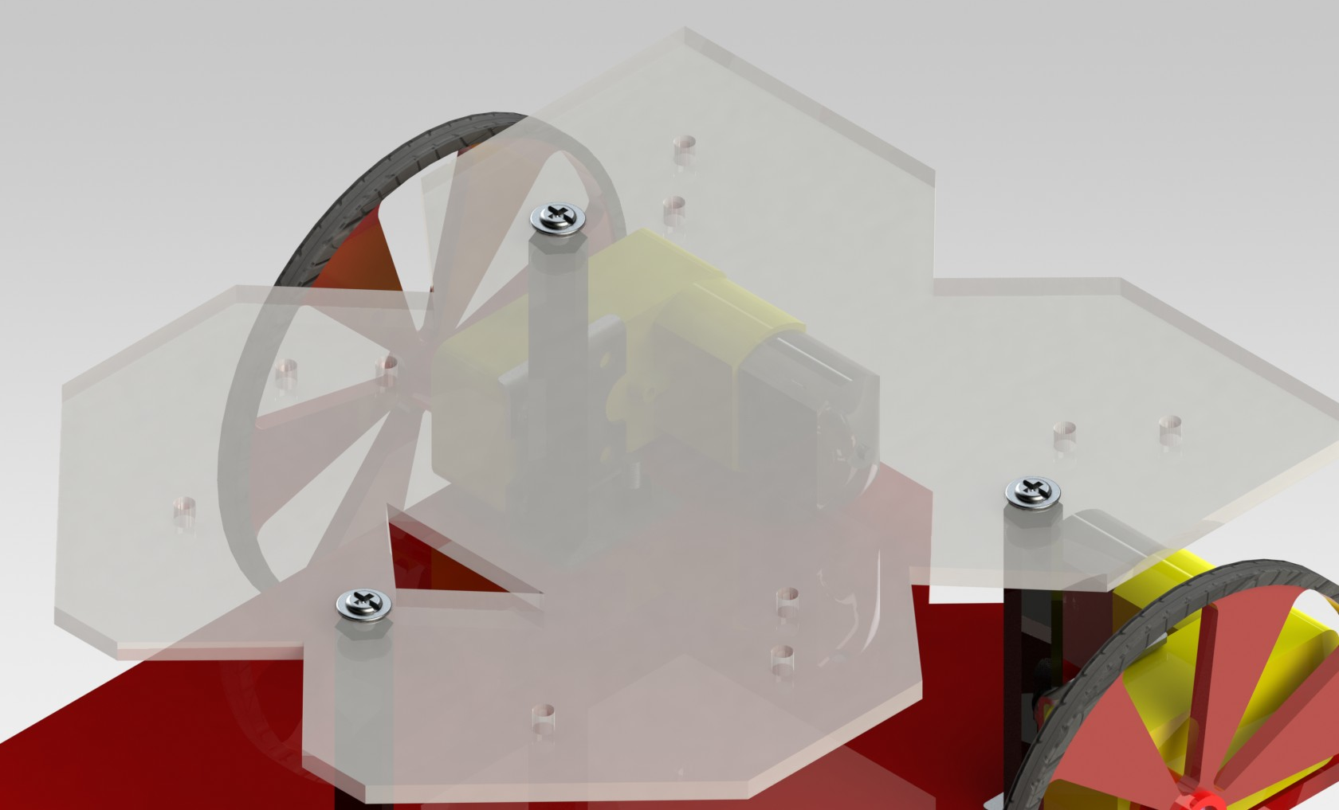
Placing the Top Plate

Slide 15
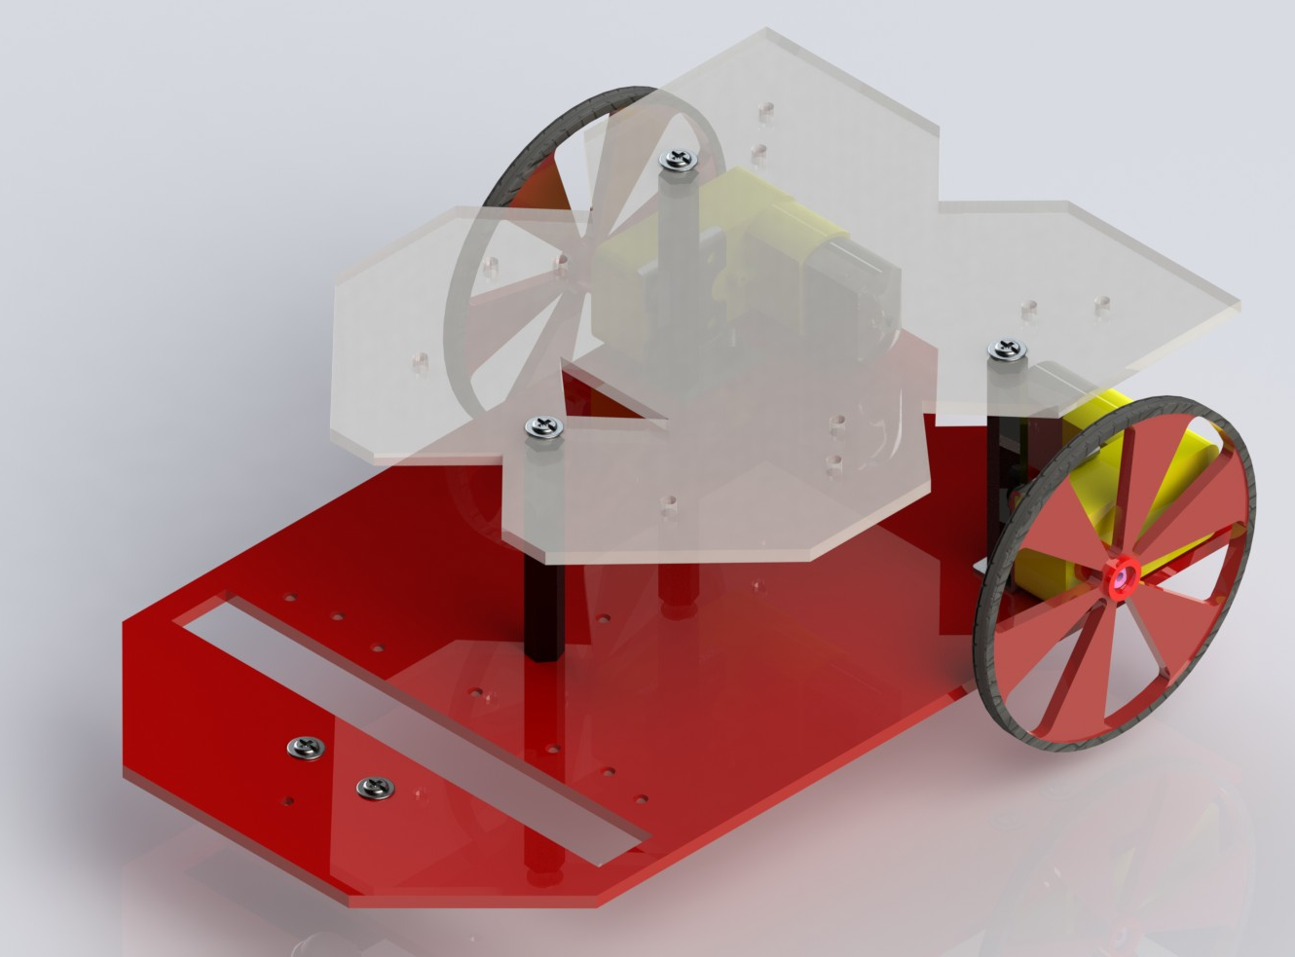
Final Bot

